Slide 1
Chapter 15 : Concurrency Control

Slide 2

Chapter 15: Concurrency Control
Lock-Based Protocols
Timestamp-Based Protocols
Validation-Based Protocols
Multiple Granularity
Multiversion Schemes
Insert and Delete Operations
Concurrency in Index Structures

Slide 3
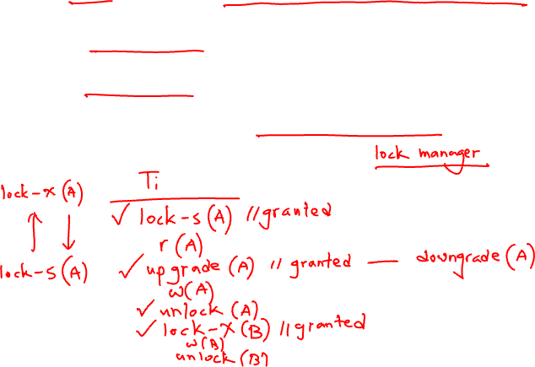
Lock-Based Protocols
A lock is a mechanism to control concurrent access to a data item
Data items can be locked in two modes :
1. exclusive (X) mode. Data item can be both read as well as
written. X-lock is requested using lock-X instruction.
2. shared (S) mode. Data item can only be read. S-lock is
requested using lock-S instruction.
Lock requests are made to concurrency-control manager. Transaction can proceed only after request is granted.

Slide 4
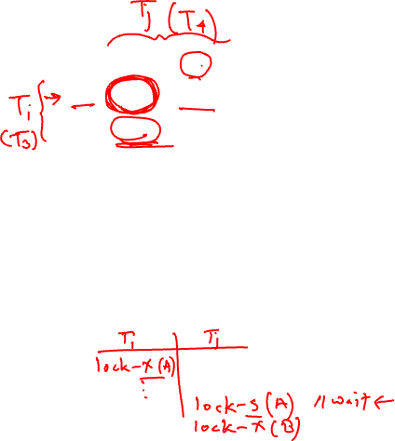

Lock-Based Protocols (Cont.)
Lock-compatibility matrix
A transaction may be granted a lock on an item if the requested lock is compatible with locks already held on the item by other transactions
Any number of transactions can hold shared locks on an item,
  but if any transaction holds an exclusive on the item no other transaction may hold any lock on the item.
If a lock cannot be granted, the requesting transaction is made to wait till all incompatible locks held by other transactions have been released. The lock is then granted.

Slide 5
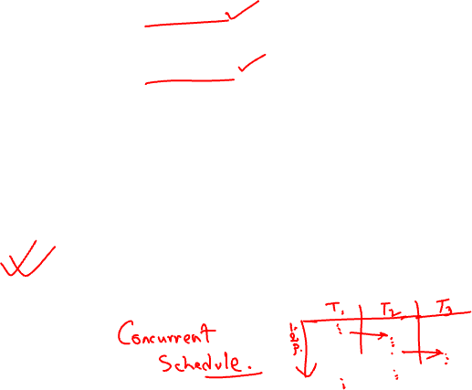
Lock-Based Protocols (Cont.)
Example of a transaction performing locking:
T₂: lock-S(A);
read (A);
unlock(A);
lock-S(B);
read (B);
unlock(B);
display(A+B)
Locking as above is not sufficient to guarantee serializability — if A and B get updated in-between the read of A and B, the displayed sum would be wrong.
A locking protocol is a set of rules followed by all transactions while requesting and releasing locks. Locking protocols restrict the set of possible schedules.

Slide 6
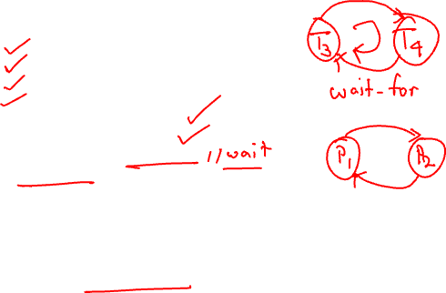

Pitfalls of Lock-Based Protocols
Consider the partial schedule
Neither T₃ nor T₄ can make progress — executing lock-S(B) causes T₄ to wait for T₃ to release its lock on B, while executing lock-X(A) causes T₃ to wait for T₄ to release its lock on A.
Such a situation is called a deadlock.
  To handle a deadlock one of T₃ or T₄ must be rolled back
  and its locks released.

Slide 7
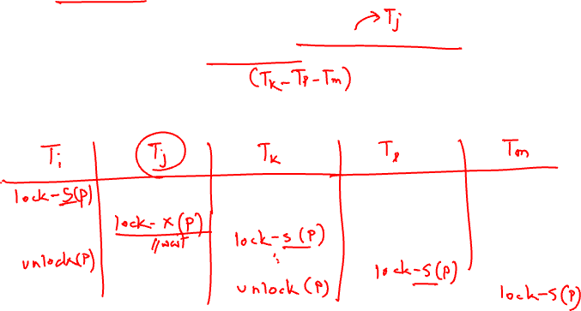
Pitfalls of Lock-Based Protocols (Cont.)
The potential for deadlock exists in most locking protocols. Deadlocks are a necessary evil.
Starvation is also possible if concurrency control manager is badly designed. For example:
  A transaction may be waiting for an X-lock on an item, while a sequence of other transactions request and are granted an S-lock on the same item.
  The same transaction is repeatedly rolled back due to deadlocks.
Concurrency control manager can be designed to prevent starvation.

Slide 8
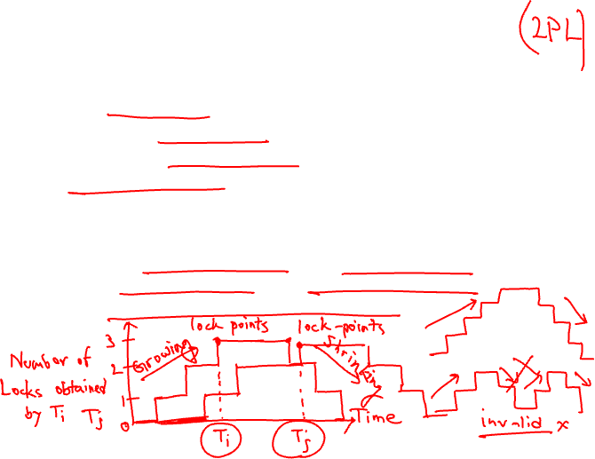
The Two-Phase Locking Protocol
This is a protocol which ensures conflict-serializable schedules.
Phase 1: Growing Phase
  transaction may obtain locks
  transaction may not release locks
Phase 2: Shrinking Phase
  transaction may release locks
  transaction may not obtain locks
The protocol assures serializability. It can be proved that the transactions can be serialized in the order of their lock points (i.e. the point where a transaction acquired its final lock).

Slide 9
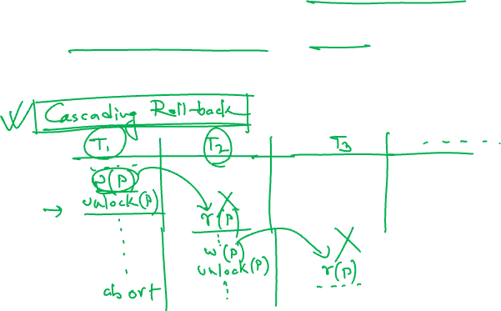
The Two-Phase Locking Protocol (Cont.)
Two-phase locking does not ensure freedom from deadlocks
Cascading roll-back is possible under two-phase locking. To avoid this, follow a modified protocol called strict two-phase locking. Here a transaction must hold all its exclusive locks till it commits/aborts.
Rigorous two-phase locking is even stricter: here all locks are held till commit/abort. In this protocol transactions can be serialized in the order in which they commit

Slide 10
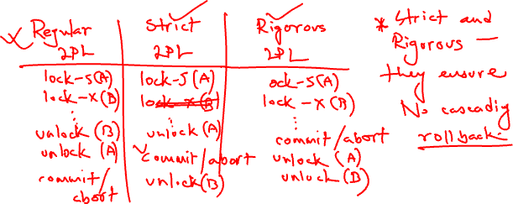
The Two-Phase Locking Protocol (Cont.)
There can be conflict serializable schedules that cannot be obtained if two-phase locking is used.
However, in the absence of extra information (e.g., ordering of access to data), two-phase locking is needed for conflict serializability in the following sense:
Given a transaction T_{i} that does not follow two-phase locking, we can find a transaction T_{j} that uses two-phase locking, and a schedule for T_{i} and T_{j} that is not conflict serializable.

Slide 11

Lock Conversions
Two-phase locking with lock conversions:
– First Phase:
  can acquire a lock-S on item
  can acquire a lock-X on item
  can convert a lock-S to a lock-X (upgrade)
– Second Phase:
  can release a lock-S
  can release a lock-X
  can convert a lock-X to a lock-S (downgrade)
This protocol assures serializability. But still relies on the programmer to insert the various locking instructions.

Slide 12
Automatic Acquisition of Locks
A transaction T_{i} issues the standard read/write instruction, without explicit locking calls.
The operation read(D) is processed as:
if T_{i} has a lock on D
then
read(D)
else begin
if necessary wait until no other
transaction has a lock-X on D
grant T_{i} a lock-S on D;
read(D)
end

Slide 13
Automatic Acquisition of Locks (Cont.)
write(D) is processed as:
if T_{i} has a lock-X on D
then
write(D)
else begin
if necessary wait until no other trans. has any lock on D,
if T_{i} has a lock-S on D
then
upgrade lock on D to lock-X
else
grant T_{i} a lock-X on D
write(D)
end;
All locks are released after commit or abort

Slide 14

Implementation of Locking
A lock manager can be implemented as a separate process to which transactions send lock and unlock requests
The lock manager replies to a lock request by sending a lock grant messages (or a message asking the transaction to roll back, in case of a deadlock)
The requesting transaction waits until its request is answered
The lock manager maintains a data-structure called a lock table to record granted locks and pending requests
The lock table is usually implemented as an in-memory hash table indexed on the name of the data item being locked

Slide 15
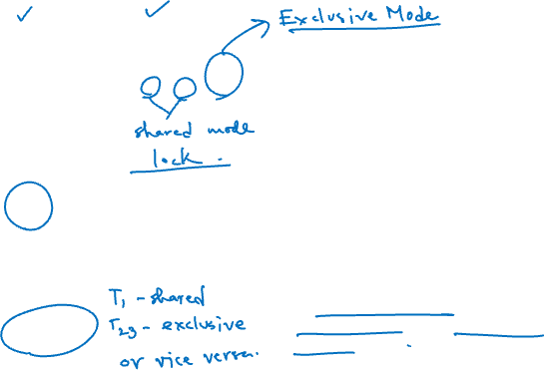
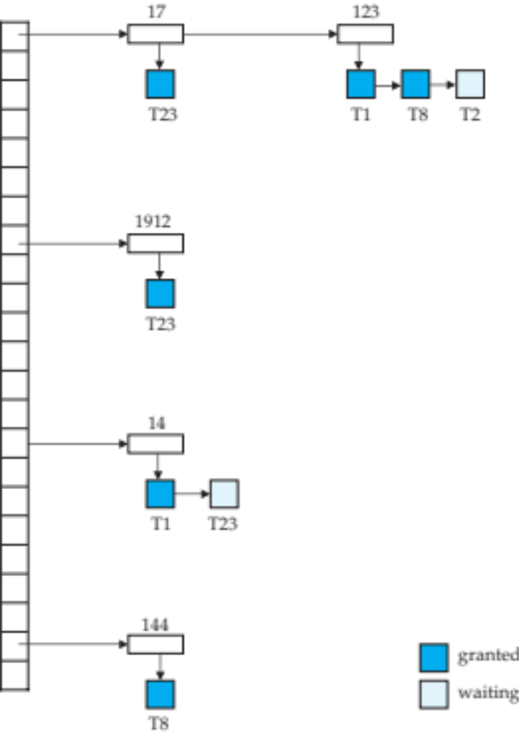
Lock Table
Black rectangles indicate granted locks, white ones indicate waiting requests
Lock table also records the type of lock granted or requested
New request is added to the end of the queue of requests for the data item, and granted if it is compatible with all earlier locks
Unlock requests result in the request being deleted, and later requests are checked to see if they can now be granted
If transaction aborts, all waiting or granted requests of the transaction are deleted
  lock manager may keep a list of locks held by each transaction, to implement this efficiently

Slide 16
Graph-Based Protocols
Graph-based protocols are an alternative to two-phase locking
Impose a partial ordering → on the set D = {d₁, d₂ ,..., d_{h}} of all data items.
  If d_{i} → d_{j} then any transaction accessing both d_{i} and d_{j} must access d_{i} before accessing d_{j}.
  Implies that the set D may now be viewed as a directed acyclic graph, called a database graph.
The tree-protocol is a simple kind of graph protocol.

Slide 17

Tree Protocol
Only exclusive locks are allowed.
The first lock by T_{i} may be on any data item. Subsequently, a data Q can be locked by T_{i} only if the parent of Q is currently locked by T_{i}.
Data items may be unlocked at any time.
A data item that has been locked and unlocked by T_{i} cannot subsequently be relocked by T_{i}

Slide 18
Graph-Based Protocols (Cont.)
The tree protocol ensures conflict serializability as well as freedom from deadlock.
Unlocking may occur earlier in the tree-locking protocol than in the two-phase locking protocol.
  shorter waiting times, and increase in concurrency
  protocol is deadlock-free, no rollbacks are required
Drawbacks
  Protocol does not guarantee recoverability or cascade freedom
    Need to introduce commit dependencies to ensure recoverability
  Transactions may have to lock data items that they do not access.
    increased locking overhead, and additional waiting time
    potential decrease in concurrency
Schedules not possible under two-phase locking are possible under tree protocol, and vice versa.

Slide 19

Deadlock Handling
Consider the following two transactions:
T₁: write (X) T₂: write(Y)
write(Y) write(X)
Schedule with deadlock

Slide 20
Deadlock Handling
System is deadlocked if there is a set of transactions such that every transaction in the set is waiting for another transaction in the set.
Deadlock prevention protocols ensure that the system will never enter into a deadlock state. Some prevention strategies :
  Require that each transaction locks all its data items before it begins execution (predeclaration).
  Impose partial ordering of all data items and require that a transaction can lock data items only in the order specified by the partial order (graph-based protocol).

Slide 21
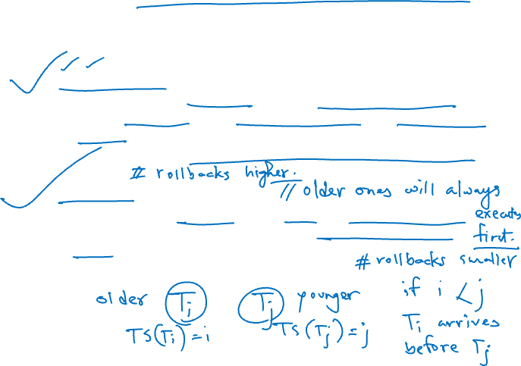
More Deadlock Prevention Strategies
Following schemes use transaction timestamps for the sake of deadlock prevention alone.
wait-die scheme — non-preemptive
  older transaction may wait for younger one to release data item. Younger transactions never wait for older ones; they are rolled back instead.
  a transaction may die several times before acquiring needed data item
wound-wait scheme — preemptive
  older transaction wounds (forces rollback) of younger transaction instead of waiting for it. Younger transactions may wait for older ones.
  may be fewer rollbacks than wait-die scheme.

Slide 22
Deadlock prevention (Cont.)
Both in wait-die and in wound-wait schemes, a rolled back transactions is restarted with its original timestamp. Older transactions thus have precedence over newer ones, and starvation is hence avoided.
Timeout-Based Schemes:
  a transaction waits for a lock only for a specified amount of time. After that, the wait times out and the transaction is rolled back.
  thus deadlocks are not possible
  simple to implement; but starvation is possible. Also difficult to determine good value of the timeout interval.

Slide 23
Deadlock Detection
Deadlocks can be described as a wait-for graph, which consists of a pair G = (V,E),
  V is a set of vertices (all the transactions in the system)
  E is a set of edges; each element is an ordered pair T_{i} →T_{j}.
If T_{i} → T_{j} is in E, then there is a directed edge from T_{i} to T_{j}, implying that T_{i} is waiting for T_{j} to release a data item.
When T_{i} requests a data item currently being held by T_{j}, then the edge T_{i} T_{j} is inserted in the wait-for graph. This edge is removed only when T_{j} is no longer holding a data item needed by T_{i}.
The system is in a deadlock state if and only if the wait-for graph has a cycle. Must invoke a deadlock-detection algorithm periodically to look for cycles.

Slide 24


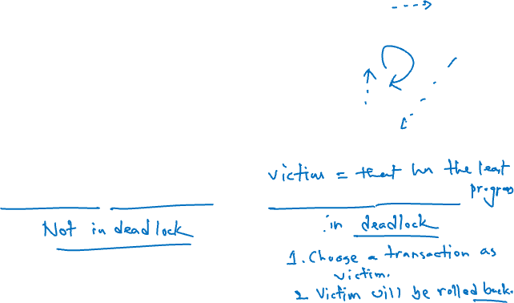
Deadlock Detection (Cont.)
Wait-for graph without a cycle
Wait-for graph with a cycle

Slide 25

Deadlock Recovery
When deadlock is detected :
  Some transaction will have to rolled back (made a victim) to break deadlock. Select that transaction as victim that will incur minimum cost.
  Rollback -- determine how far to roll back transaction
    Total rollback: Abort the transaction and then restart it.
    More effective to roll back transaction only as far as necessary to break deadlock.
  Starvation happens if same transaction is always chosen as victim. Include the number of rollbacks in the cost factor to avoid starvation

Slide 26
Multiple Granularity
Allow data items to be of various sizes and define a hierarchy of data granularities, where the small granularities are nested within larger ones
Can be represented graphically as a tree (but don't confuse with tree-locking protocol)
When a transaction locks a node in the tree explicitly, it implicitly locks all the node's descendents in the same mode.
Granularity of locking (level in tree where locking is done):
  fine granularity (lower in tree): high concurrency, high locking overhead
  coarse granularity (higher in tree): low locking overhead, low concurrency

Slide 27

Example of Granularity Hierarchy
The levels, starting from the coarsest (top) level are
  database
  area
  file
  record

Slide 28
Intention Lock Modes
In addition to S and X lock modes, there are three additional lock modes with multiple granularity:
  intention-shared (IS): indicates explicit locking at a lower level of the tree but only with shared locks.
  intention-exclusive (IX): indicates explicit locking at a lower level with exclusive or shared locks
  shared and intention-exclusive (SIX): the subtree rooted by that node is locked explicitly in shared mode and explicit locking is being done at a lower level with exclusive-mode locks.
intention locks allow a higher level node to be locked in S or X mode without having to check all descendent nodes.

Slide 29

Compatibility Matrix with Intention Lock Modes
The compatibility matrix for all lock modes is:

Slide 30
Multiple Granularity Locking Scheme
Transaction T_{i} can lock a node Q, using the following rules:
  The lock compatibility matrix must be observed.
  The root of the tree must be locked first, and may be locked in any mode.
  A node Q can be locked by T_{i} in S or IS mode only if the parent of Q is currently locked by T_{i} in either IX or IS mode.
  A node Q can be locked by T_{i} in X, SIX, or IX mode only if the parent of Q is currently locked by T_{i} in either IX or SIX mode.
  T_{i} can lock a node only if it has not previously unlocked any node (that is, T_{i} is two-phase).
  T_{i} can unlock a node Q only if none of the children of Q are currently locked by T_{i}.
Observe that locks are acquired in root-to-leaf order, whereas they are released in leaf-to-root order.
Lock granularity escalation: in case there are too many locks at a particular level, switch to higher granularity S or X lock

Slide 31
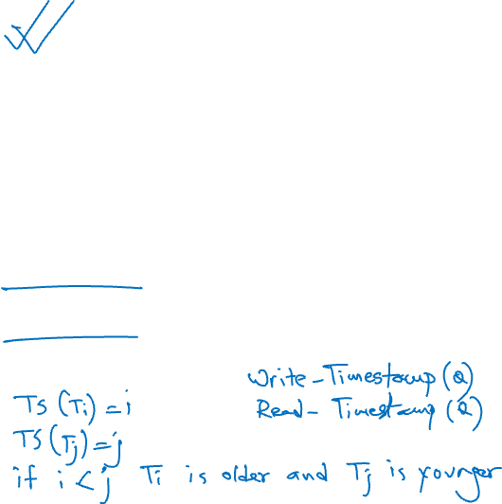
Timestamp-Based Protocols
Each transaction is issued a timestamp when it enters the system. If an old transaction T_{i} has time-stamp TS(T_{i}), a new transaction T_{j} is assigned time-stamp TS(T_{j}) such that TS(T_{i}) <TS(T_{j}).
The protocol manages concurrent execution such that the time-stamps determine the serializability order.
In order to assure such behavior, the protocol maintains for each data Q two timestamp values:
  W-timestamp(Q) is the largest time-stamp of any transaction that executed write(Q) successfully.
  R-timestamp(Q) is the largest time-stamp of any transaction that executed read(Q) successfully.

Slide 32
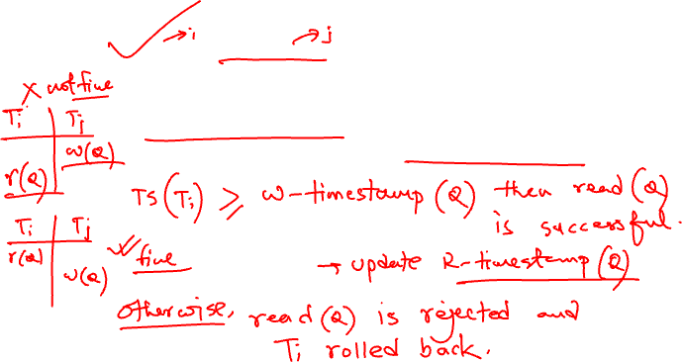
Timestamp-Based Protocols (Cont.)
The timestamp ordering protocol ensures that any conflicting read and write operations are executed in timestamp order.
Suppose a transaction T_{i} issues a read(Q)
  If TS(T_{i}) < W-timestamp(Q), then T_{i} needs to read a value of Q that was already overwritten.
    Hence, the read operation is rejected, and T_{i} is rolled back.
  If TS(T_{i}) >= W-timestamp(Q), then the read operation is executed, and R-timestamp(Q) is set to max(R-timestamp(Q), TS(T_{i})).

Slide 33
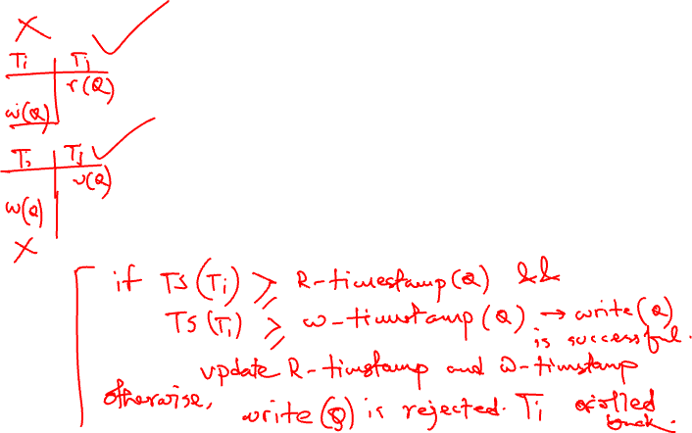
Timestamp-Based Protocols (Cont.)
Suppose that transaction T_{i} issues write(Q).
  If TS(T_{i}) < R-timestamp(Q), then the value of Q that T_{i} is producing was needed previously, and the system assumed that that value would never be produced.
    Hence, the write operation is rejected, and T_{i} is rolled back.
  If TS(T_{i}) < W-timestamp(Q), then T_{i} is attempting to write an obsolete value of Q.
    Hence, this write operation is rejected, and T_{i} is rolled back.
  Otherwise, the write operation is executed, and W-timestamp(Q) is set to TS(T_{i}).

Slide 34

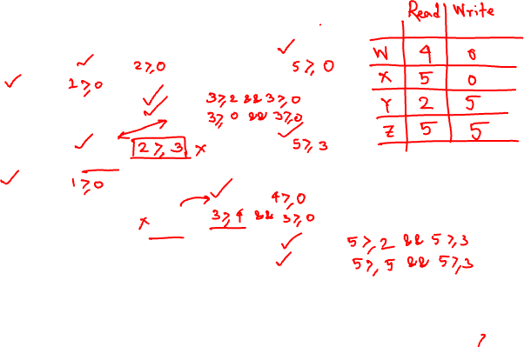

Example Use of the Protocol
A partial schedule for several data items for transactions with
timestamps 1, 2, 3, 4, 5

Slide 35

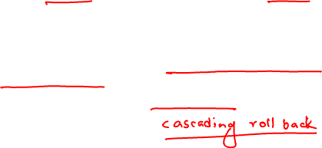
Correctness of Timestamp-Ordering Protocol
The timestamp-ordering protocol guarantees serializability since all the arcs in the precedence graph are of the form:
Thus, there will be no cycles in the precedence graph
Timestamp protocol ensures freedom from deadlock as no transaction ever waits.
But the schedule may not be cascade-free, and may not even be recoverable.

Slide 36
Recoverability and Cascade Freedom
Problem with timestamp-ordering protocol:
  Suppose T_{i} aborts, but T_{j} has read a data item written by T_{i}
  Then T_{j} must abort; if T_{j} had been allowed to commit earlier, the schedule is not recoverable.
  Further, any transaction that has read a data item written by T_{j} must abort
  This can lead to cascading rollback --- that is, a chain of rollbacks
Solution 1:
  A transaction is structured such that its writes are all performed at the end of its processing
  All writes of a transaction form an atomic action; no transaction may execute while a transaction is being written
  A transaction that aborts is restarted with a new timestamp
Solution 2: Limited form of locking: wait for data to be committed before reading it
Solution 3: Use commit dependencies to ensure recoverability

Slide 37
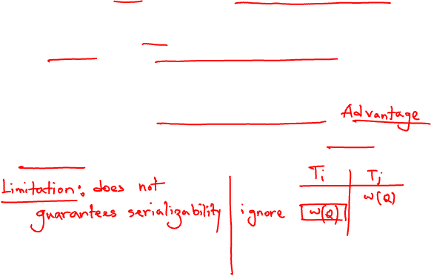
Thomas’ Write Rule
Modified version of the timestamp-ordering protocol in which obsolete write operations may be ignored under certain circumstances.
When T_{i} attempts to write data item Q, if TS(T_{i}) < W-timestamp(Q), then T_{i} is attempting to write an obsolete value of {Q}.
  Rather than rolling back T_{i} as the timestamp ordering protocol would have done, this {write} operation can be ignored.
Otherwise this protocol is the same as the timestamp ordering protocol.
Thomas' Write Rule allows greater potential concurrency.
  Allows some view-serializable schedules that are not conflict-serializable.

Slide 38
View Serializability
Let S and S´ be two schedules with the same set of transactions. S and S´ are view equivalent if the following three conditions are met, for each data item Q,
  If in schedule S, transaction T_{i} reads the initial value of Q, then in schedule S’ also transaction T_{i} must read the initial value of Q.
  If in schedule S transaction T_{i} executes read(Q), and that value was produced by transaction T_{j} (if any), then in schedule S’ also transaction T_{i} must read the value of Q that was produced by the same write(Q) operation of transaction T_{j} .
  The transaction (if any) that performs the final write(Q) operation in schedule S must also perform the final write(Q) operation in schedule S’.
As can be seen, view equivalence is also based purely on reads and writes alone.

Slide 39
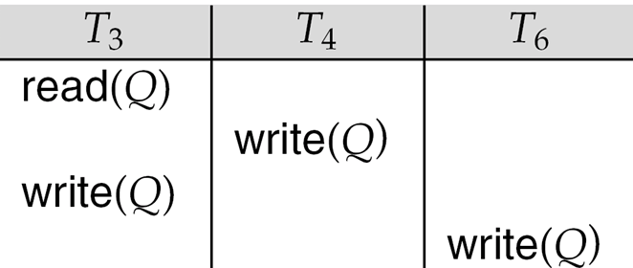
View Serializability (Cont.)
A schedule S is view serializable if it is view equivalent to a serial schedule.
Every conflict serializable schedule is also view serializable.
Below is a schedule which is view-serializable but not conflict serializable.
What serial schedule is above equivalent to?
Every view serializable schedule that is not conflict serializable has blind writes.

Slide 40
Test for View Serializability
The precedence graph test for conflict serializability cannot be used directly to test for view serializability.
  Extension to test for view serializability has cost exponential in the size of the precedence graph.
The problem of checking if a schedule is view serializable falls in the class of NP-complete problems.
  Thus existence of an efficient algorithm is extremely unlikely.
However practical algorithms that just check some sufficient conditions for view serializability can still be used.

Slide 41
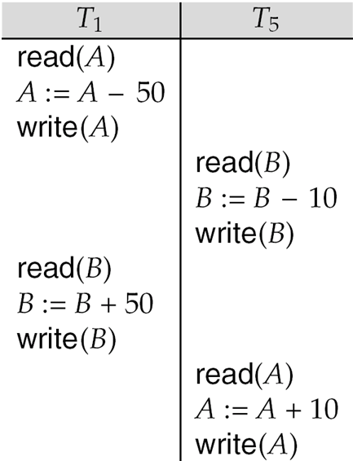
Other Notions of Serializability
The schedule below produces same outcome as the serial schedule < T₁, T₅ >, yet is not conflict equivalent or view equivalent to it.
Determining such equivalence requires analysis of operations other than read and write.
  Operation-conflicts, operation locks

Slide 42
Validation-Based Protocol
Execution of transaction T_{i} is done in three phases.
1. Read and execution phase: Transaction T_{i} writes only to
temporary local variables
2. Validation phase: Transaction T_{i} performs a ``validation test''
to determine if local variables can be written without violating
serializability.
3. Write phase: If T_{i} is validated, the updates are applied to the
database; otherwise, T_{i} is rolled back.
The three phases of concurrently executing transactions can be interleaved, but each transaction must go through the three phases in that order.
  Assume for simplicity that the validation and write phase occur together, atomically and serially
    I.e., only one transaction executes validation/write at a time.
Also called as optimistic concurrency control since transaction executes fully in the hope that all will go well during validation

Slide 43
Validation-Based Protocol (Cont.)
Each transaction T_{i} has 3 timestamps
  Start(T_{i}) : the time when T_{i} started its execution
  Validation(T_{i}): the time when T_{i} entered its validation phase
  Finish(T_{i}) : the time when T_{i} finished its write phase
Serializability order is determined by timestamp given at validation time, to increase concurrency.
  Thus TS(T_{i}) is given the value of Validation(T_{i}).
This protocol is useful and gives greater degree of concurrency if probability of conflicts is low.
  because the serializability order is not pre-decided, and
  relatively few transactions will have to be rolled back.

Slide 44
Validation Test for Transaction T_{j}
If for all T_{i} with TS (T_{i}) < TS (T_{j}) either one of the following condition holds:
  finish(T_{i}) < start(T_{j})
  start(T_{j}) < finish(T_{i}) < validation(T_{j}) and the set of data items written by T_{i} does not intersect with the set of data items read by T_{j}.
then validation succeeds and T_{j} can be committed. Otherwise, validation fails and T_{j} is aborted.
Justification: Either the first condition is satisfied, and there is no overlapped execution, or the second condition is satisfied and
  the writes of T_{j} do not affect reads of T_{i} since they occur after T_{i} has finished its reads.
  the writes of T_{i} do not affect reads of T_{j} since T_{j} does not read any item written by T_{i}.

Slide 45

Schedule Produced by Validation
Example of schedule produced using validation

Slide 46
Multiversion Schemes
Multiversion schemes keep old versions of data item to increase concurrency.
  Multiversion Timestamp Ordering
  Multiversion Two-Phase Locking
Each successful write results in the creation of a new version of the data item written.
Use timestamps to label versions.
When a read(Q) operation is issued, select an appropriate version of Q based on the timestamp of the transaction, and return the value of the selected version.
reads never have to wait as an appropriate version is returned immediately.

Slide 47
Multiversion Timestamp Ordering
Each data item Q has a sequence of versions <Q₁, Q₂,...., Q_{m}>. Each version Q_{k} contains three data fields:
  Content -- the value of version Q_{k}.
  W-timestamp(Q_{k}) -- timestamp of the transaction that created (wrote) version Q_{k}
  R-timestamp(Q_{k}) -- largest timestamp of a transaction that successfully read version Q_{k}
when a transaction T_{i} creates a new version Q_{k} of Q, Q_{k}'s W-timestamp and R-timestamp are initialized to TS(T_{i}).
R-timestamp of Q_{k} is updated whenever a transaction T_{j} reads Q_{k}, and TS(T_{j}) > R-timestamp(Q_{k}).

Slide 48
Multiversion Timestamp Ordering (Cont)
Suppose that transaction T_{i} issues a read(Q) or write(Q) operation. Let Q_{k} denote the version of Q whose write timestamp is the largest write timestamp less than or equal to TS(T_{i}).
  If transaction T_{i} issues a read(Q), then the value returned is the content of version Q_{k}.
  If transaction T_{i} issues a write(Q)
    if TS(T_{i}) < R-timestamp(Q_{k}), then transaction T_{i} is rolled back.
    if TS(T_{i}) = W-timestamp(Q_{k}), the contents of Q_{k} are overwritten
    else a new version of Q is created.
Observe that
  Reads always succeed
  A write by T_{i} is rejected if some other transaction T_{j} that (in the serialization order defined by the timestamp values) should read
  T_{i}'s write, has already read a version created by a transaction older than T_{i}.
Protocol guarantees serializability

Slide 49
Multiversion Two-Phase Locking
Differentiates between read-only transactions and update transactions
Update transactions acquire read and write locks, and hold all locks up to the end of the transaction. That is, update transactions follow rigorous two-phase locking.
  Each successful write results in the creation of a new version of the data item written.
  each version of a data item has a single timestamp whose value is obtained from a counter ts-counter that is incremented during commit processing.
Read-only transactions are assigned a timestamp by reading the current value of ts-counter before they start execution; they follow the multiversion timestamp-ordering protocol for performing reads.

Slide 50
Multiversion Two-Phase Locking (Cont.)
When an update transaction wants to read a data item:
  it obtains a shared lock on it, and reads the latest version.
When it wants to write an item
  it obtains X lock on; it then creates a new version of the item and sets this version's timestamp to ∞.
When update transaction T_{i} completes, commit processing occurs:
  T_{i} sets timestamp on the versions it has created to ts-counter + 1
  T_{i} increments ts-counter by 1
Read-only transactions that start after T_{i} increments ts-counter will see the values updated by T_{i}.
Read-only transactions that start before T_{i} increments the
ts-counter will see the value before the updates by T_{i}.
Only serializable schedules are produced.

Slide 51
MVCC: Implementation Issues
Creation of multiple versions increases storage overhead
  Extra tuples
  Extra space in each tuple for storing version information
Versions can, however, be garbage collected
  E.g. if Q has two versions Q5 and Q9, and the oldest active transaction has timestamp > 9, than Q5 will never be required again

Slide 52

Snapshot Isolation
Motivation: Decision support queries that read large amounts of data have concurrency conflicts with OLTP transactions that update a few rows
  Poor performance results
Solution 1: Give logical “snapshot” of database state to read only transactions, read-write transactions use normal locking
  Multiversion 2-phase locking
  Works well, but how does system know a transaction is read only?
Solution 2: Give snapshot of database state to every transaction, updates alone use 2-phase locking to guard against concurrent updates
  Problem: variety of anomalies such as lost update can result
  Partial solution: snapshot isolation level (next slide)
    Proposed by Berenson et al, SIGMOD 1995
    Variants implemented in many database systems
      E.g. Oracle, PostgreSQL, SQL Server 2005

Slide 53
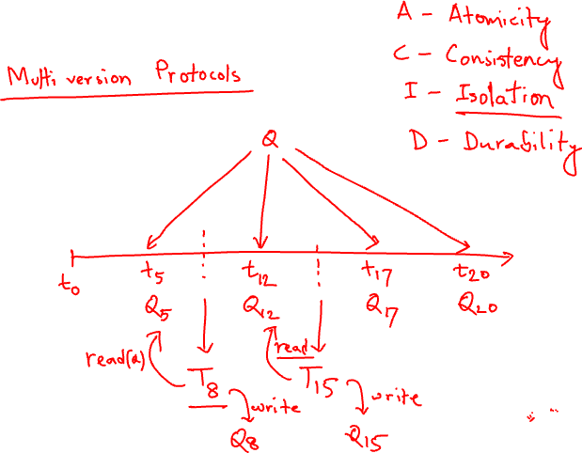

Slide 54
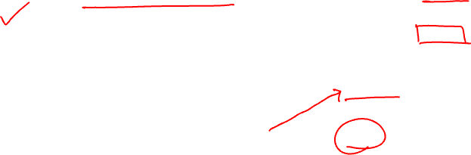
Snapshot Isolation
A transaction T1 executing with Snapshot Isolation
  takes snapshot of committed data at start
  always reads/modifies data in its own snapshot
  updates of concurrent transactions are not visible to T1
  writes of T1 complete when it commits
  First-committer-wins rule:
    Commits only if no other concurrent transaction has already written data that T1 intends to write.
T1 | T2 | T3
W(Y := 1) Commit
 | Start R(X) → 0 R(Y)→ 1
 |  | W(X:=2) W(Z:=3) Commit
 | R(Z) → 0 R(Y) → 1 W(X:=3) Commit-Req Abort
Concurrent updates not visible
Own updates are visible
Not first-committer of X
Serialization error, T2 is rolled back

Slide 55
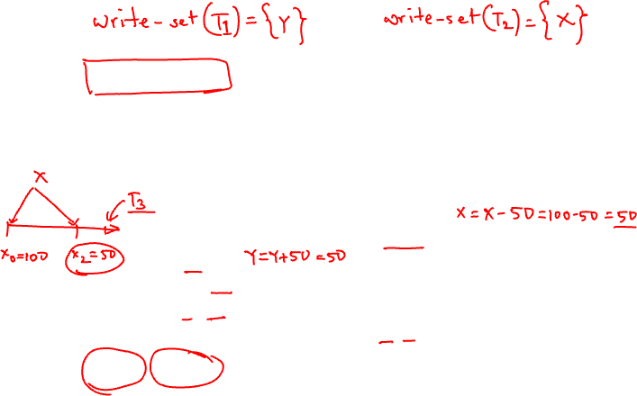

Snapshot Read
Concurrent updates invisible to snapshot read

Slide 56

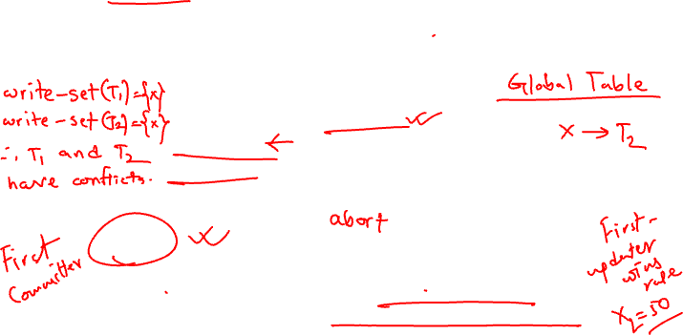
Snapshot Write: First Committer Wins
  Variant: “First-updater-wins”
    Check for concurrent updates when write occurs by locking item
      But lock should be held till all concurrent transactions have finished
    (Oracle uses this plus some extra features)
    Differs only in when abort occurs, otherwise equivalent

Slide 57
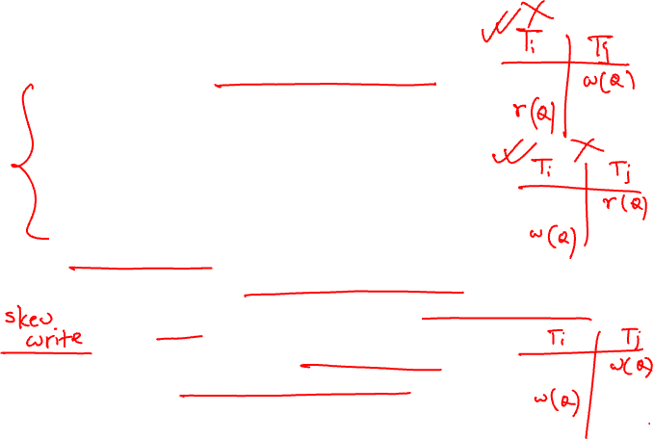

Benefits of SI
Reading is never blocked,
  and also doesn’t block other txns activities
Performance similar to Read Committed
Avoids the usual anomalies
  No dirty read
  No lost update
  No non-repeatable read
  Predicate based selects are repeatable (no phantoms)
Problems with SI
  SI does not always give serializable executions
    Serializable: among two concurrent txns, one sees the effects of the other
    In SI: neither sees the effects of the other
  Result: Integrity constraints can be violated

Slide 58

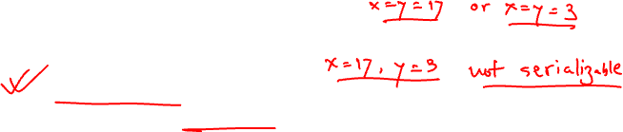
Snapshot Isolation
E.g. of problem with SI
  T1: x:=y
  T2: y:= x
  Initially x = 3 and y = 17
    Serial execution: x = ??, y = ??
    if both transactions start at the same time, with snapshot isolation: x = ?? , y = ??
Called skew write
Skew also occurs with inserts
  E.g:
    Find max order number among all orders
    Create a new order with order number = previous max + 1

Slide 59
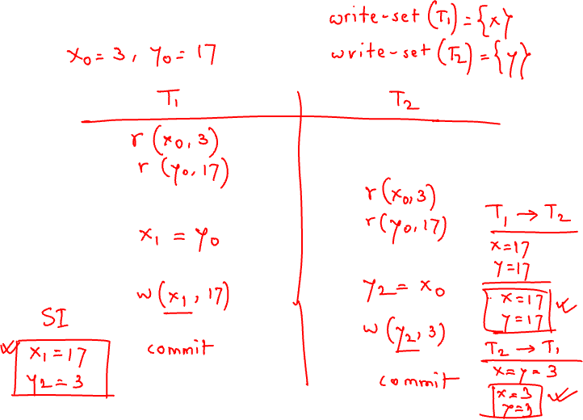

Slide 60
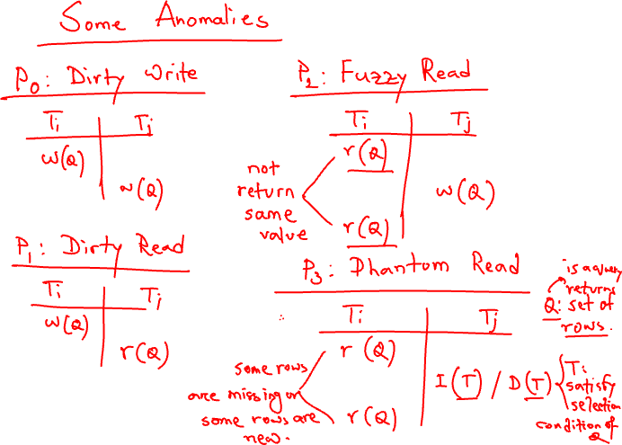

Slide 61
Syllabus of Final
Selection algorithms A7-A10 (Ch # 12)
Join Algorithms (Ch # 12)
Sort-Merge Algorithms (Ch # 12)
Basics of Query Optimization (Ch # 13)
Left deep join tree, right deep join tree (Ch # 13)
Estimating size of selection, complex selections, join, project, set operations (Ch # 13)
Lock-based, Timestamp-based, Thomas’ Write Rule, Snapshot Isolation (CH # 15)
Deadlock Prevention (wait-for graph), Recovery (Ch # 15)

Slide 62
Snapshot Isolation Anomalies
SI breaks serializability when txns modify different items, each based on a previous state of the item the other modified
  Not very common in practice
    E.g., the TPC-C benchmark runs correctly under SI
    when txns conflict due to modifying different data, there is usually also a shared item they both modify too (like a total quantity) so SI will abort one of them
  But does occur
    Application developers should be careful about write skew
SI can also cause a read-only transaction anomaly, where read-only transaction may see an inconsistent state even if updaters are serializable
  We omit details
Using snapshots to verify primary/foreign key integrity can lead to inconsistency
  Integrity constraint checking usually done outside of snapshot

Slide 63
SI In Oracle and PostgreSQL
Warning: SI used when isolation level is set to serializable, by Oracle, and PostgreSQL versions prior to 9.1
  PostgreSQL’s implementation of SI (versions prior to 9.1) described in Section 26.4.1.3
  Oracle implements “first updater wins” rule (variant of “first committer wins”)
    concurrent writer check is done at time of write, not at commit time
    Allows transactions to be rolled back earlier
    Oracle and PostgreSQL < 9.1 do not support true serializable execution
  PostgreSQL 9.1 introduced new protocol called “Serializable Snapshot Isolation” (SSI)
    Which guarantees true serializabilty including handling predicate reads (coming up)

Slide 64
SI In Oracle and PostgreSQL
Can sidestep SI for specific queries by using select .. for update in Oracle and PostgreSQL
  E.g.,
    select max(orderno) from orders for update
    read value into local variable maxorder
    insert into orders (maxorder+1, …)
  Select for update (SFU) treats all data read by the query as if it were also updated, preventing concurrent updates
  Does not always ensure serializability since phantom phenomena can occur (coming up)
In PostgreSQL versions < 9.1, SFU locks the data item, but releases locks when the transaction completes, even if other concurrent transactions are active
  Not quite same as SFU in Oracle, which keeps locks until all
  concurrent transactions have completed

Slide 65
Insert and Delete Operations
If two-phase locking is used :
  A delete operation may be performed only if the transaction deleting the tuple has an exclusive lock on the tuple to be deleted.
  A transaction that inserts a new tuple into the database is given an X-mode lock on the tuple
Insertions and deletions can lead to the phantom phenomenon.
  A transaction that scans a relation
    (e.g., find sum of balances of all accounts in Perryridge)
    and a transaction that inserts a tuple in the relation
    (e.g., insert a new account at Perryridge)
    (conceptually) conflict in spite of not accessing any tuple in common.
  If only tuple locks are used, non-serializable schedules can result
    E.g. the scan transaction does not see the new account, but reads some other tuple written by the update transaction

Slide 66
Insert and Delete Operations (Cont.)
The transaction scanning the relation is reading information that indicates what tuples the relation contains, while a transaction inserting a tuple updates the same information.
  The conflict should be detected, e.g. by locking the information.
One solution:
  Associate a data item with the relation, to represent the information about what tuples the relation contains.
  Transactions scanning the relation acquire a shared lock in the data item,
  Transactions inserting or deleting a tuple acquire an exclusive lock on the data item. (Note: locks on the data item do not conflict with locks on individual tuples.)
Above protocol provides very low concurrency for insertions/deletions.
Index locking protocols provide higher concurrency while
preventing the phantom phenomenon, by requiring locks
on certain index buckets.

Slide 67
Index Locking Protocol
Index locking protocol:
  Every relation must have at least one index.
  A transaction can access tuples only after finding them through one or more indices on the relation
  A transaction T_{i} that performs a lookup must lock all the index leaf nodes that it accesses, in S-mode
    Even if the leaf node does not contain any tuple satisfying the index lookup (e.g. for a range query, no tuple in a leaf is in the range)
  A transaction T_{i} that inserts, updates or deletes a tuple t_{i} in a relation r
    must update all indices to r
    must obtain exclusive locks on all index leaf nodes affected by the insert/update/delete
  The rules of the two-phase locking protocol must be observed
Guarantees that phantom phenomenon won’t occur

Slide 68
Next-Key Locking
Index-locking protocol to prevent phantoms required locking entire leaf
  Can result in poor concurrency if there are many inserts
Alternative: for an index lookup
  Lock all values that satisfy index lookup (match lookup value, or fall in lookup range)
  Also lock next key value in index
  Lock mode: S for lookups, X for insert/delete/update
Ensures that range queries will conflict with inserts/deletes/updates
  Regardless of which happens first, as long as both are concurrent

Slide 69
Concurrency in Index Structures
Indices are unlike other database items in that their only job is to help in accessing data.
Index-structures are typically accessed very often, much more than other database items.
  Treating index-structures like other database items, e.g. by 2-phase locking of index nodes can lead to low concurrency.
There are several index concurrency protocols where locks on internal nodes are released early, and not in a two-phase fashion.
  It is acceptable to have nonserializable concurrent access to an index as long as the accuracy of the index is maintained.
    In particular, the exact values read in an internal node of a
    B⁺-tree are irrelevant so long as we land up in the correct leaf node.

Slide 70
Concurrency in Index Structures (Cont.)
Example of index concurrency protocol:
Use crabbing instead of two-phase locking on the nodes of the B⁺-tree, as follows. During search/insertion/deletion:
  First lock the root node in shared mode.
  After locking all required children of a node in shared mode, release the lock on the node.
  During insertion/deletion, upgrade leaf node locks to exclusive mode.
  When splitting or coalescing requires changes to a parent, lock the parent in exclusive mode.
Above protocol can cause excessive deadlocks
  Searches coming down the tree deadlock with updates going up the tree
  Can abort and restart search, without affecting transaction
Better protocols are available; see Section 16.9 for one such protocol, the B-link tree protocol
  Intuition: release lock on parent before acquiring lock on child
    And deal with changes that may have happened between lock release and acquire

Slide 71
Weak Levels of Consistency
Degree-two consistency: differs from two-phase locking in that S-locks may be released at any time, and locks may be acquired at any time
  X-locks must be held till end of transaction
  Serializability is not guaranteed, programmer must ensure that no erroneous database state will occur]
Cursor stability:
  For reads, each tuple is locked, read, and lock is immediately released
  X-locks are held till end of transaction
  Special case of degree-two consistency

Slide 72
Weak Levels of Consistency in SQL
SQL allows non-serializable executions
  Serializable: is the default
  Repeatable read: allows only committed records to be read, and repeating a read should return the same value (so read locks should be retained)
    However, the phantom phenomenon need not be prevented
      T1 may see some records inserted by T2, but may not see others inserted by T2
  Read committed: same as degree two consistency, but most systems implement it as cursor-stability
  Read uncommitted: allows even uncommitted data to be read
In many database systems, read committed is the default consistency level
  has to be explicitly changed to serializable when required
    set isolation level serializable

Slide 73
Transactions across User Interaction
Many applications need transaction support across user interactions
  Can’t use locking
  Don’t want to reserve database connection per user
Application level concurrency control
  Each tuple has a version number
  Transaction notes version number when reading tuple
    select r.balance, r.version into :A, :version
    from r where acctId =23
  When writing tuple, check that current version number is same as the version when tuple was read
    update r set r.balance = r.balance + :deposit
    where acctId = 23 and r.version = :version
Equivalent to optimistic concurrency control without validating read set
Used internally in Hibernate ORM system, and manually in many applications
Version numbering can also be used to support first committer wins check of snapshot isolation
  Unlike SI, reads are not guaranteed to be from a single snapshot

Slide 74
End of Chapter
Thanks to Alan Fekete and Sudhir Jorwekar for Snapshot Isolation examples

Slide 75
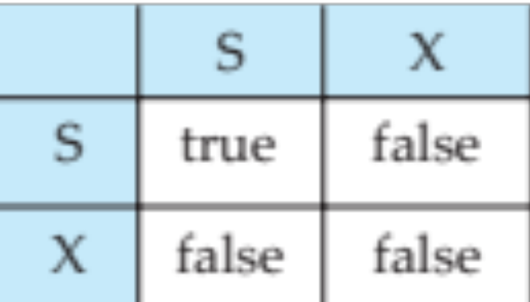
Figure 15.01

Slide 76
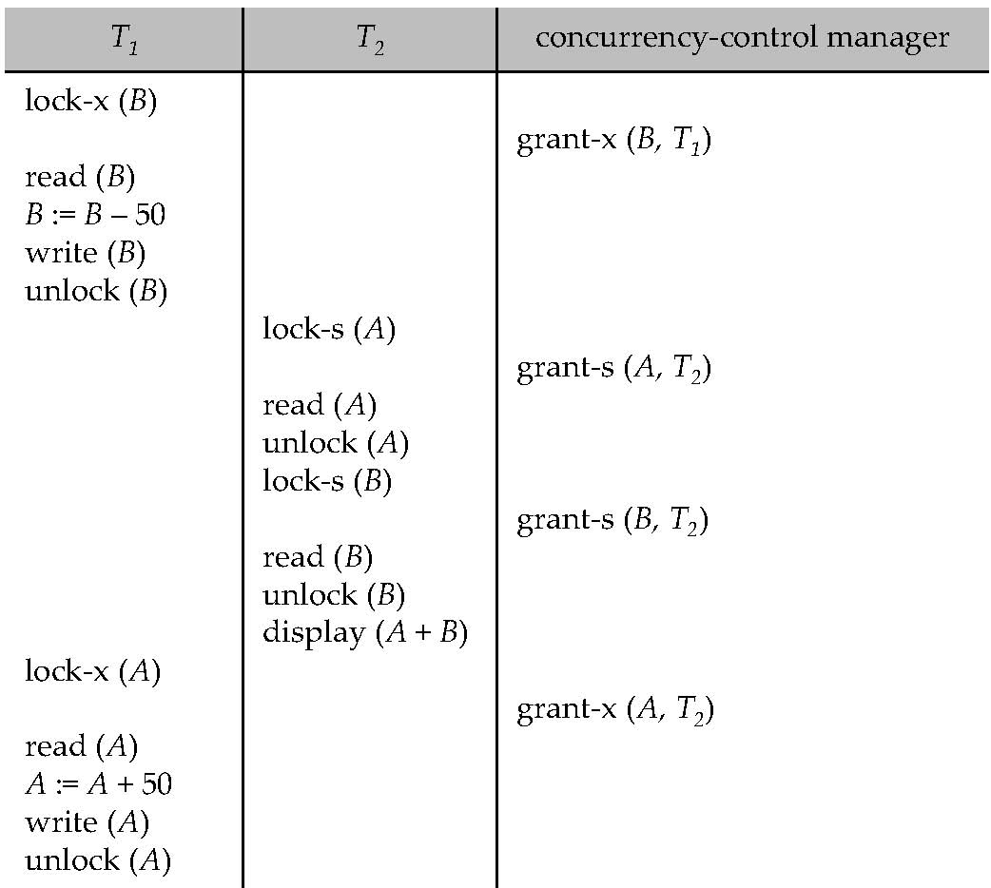
Figure 15.04

Slide 77
Figure 15.07

Slide 78
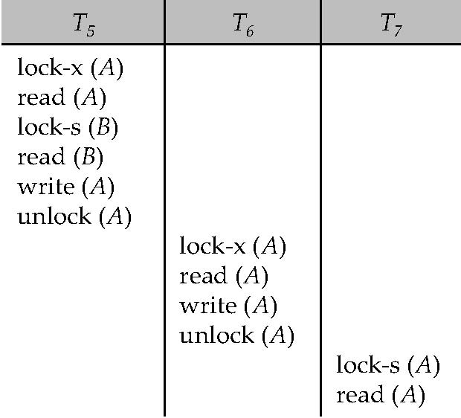
Figure 15.08

Slide 79
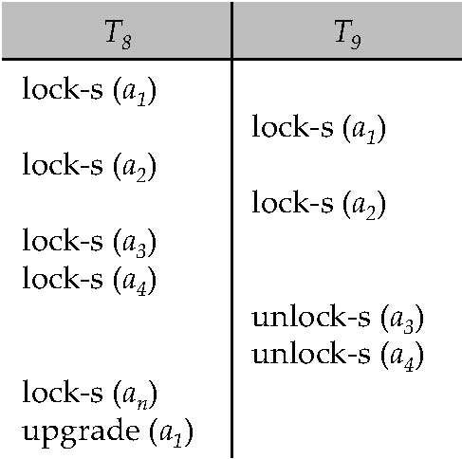
Figure 15.09

Slide 80
Figure 15.10

Slide 81
Figure 15.11

Slide 82
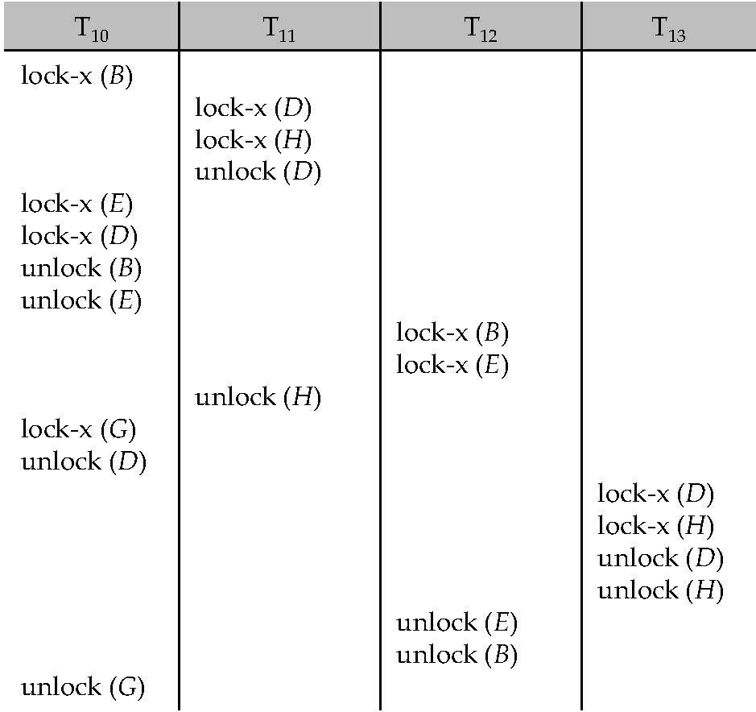
Figure 15.12

Slide 83
Figure 15.13

Slide 84
Figure 15.14

Slide 85
Figure 15.15

Slide 86
Figure 15.16

Slide 87
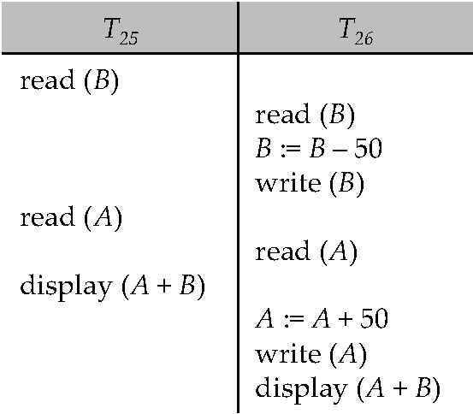
Figure 15.17

Slide 88
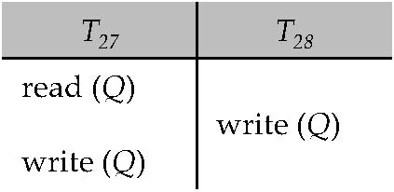
Figure 15.18

Slide 89
Figure 15.19

Slide 90
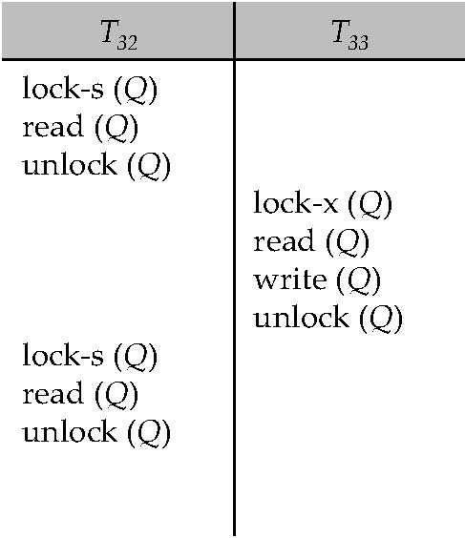
Figure 15.20

Slide 91
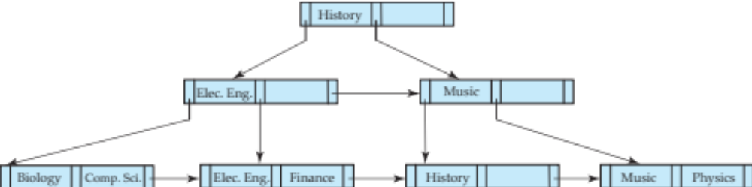
Figure 15.21

Slide 92
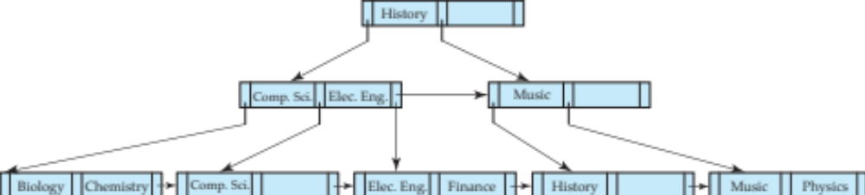
Figure 15.22

Slide 93
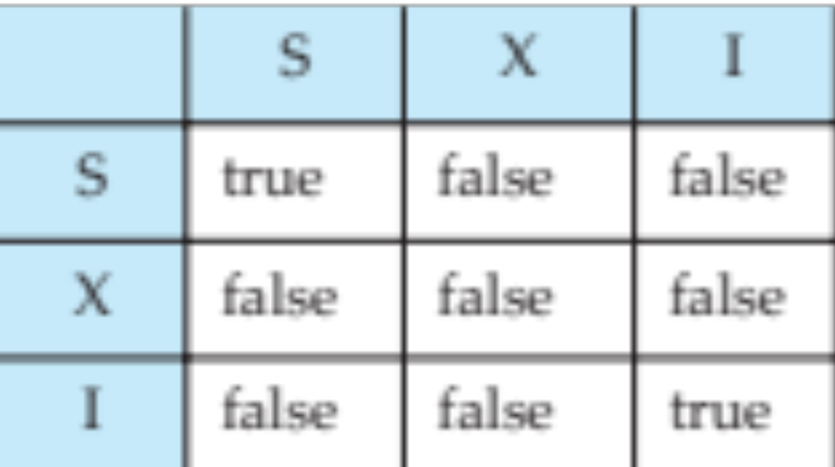
Figure 15.23

Slide 94
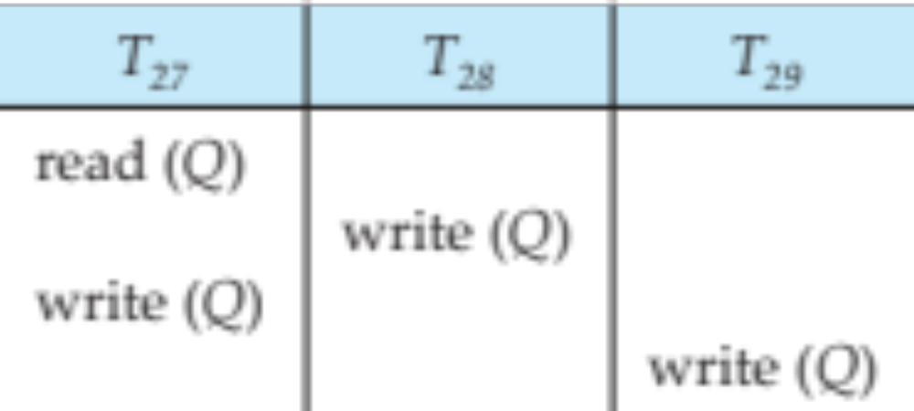
Figure in-15.1

